Slide 1
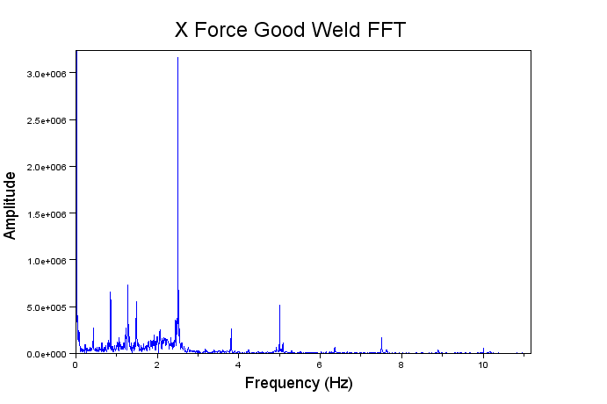
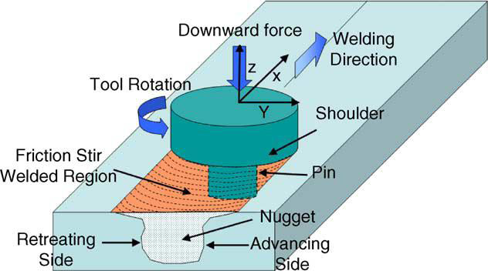
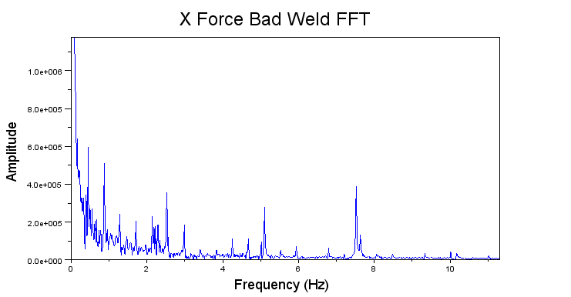
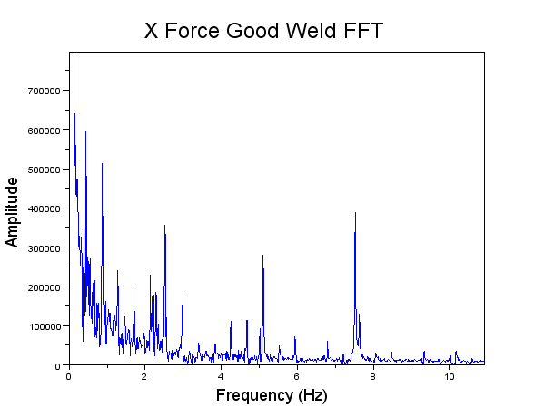
Developing Intelligent Friction Stir Welding Algorithms
Research Undergraduate: Jennifer Johnson, Black Hills State University
Advisors: Dr. Edward Corwin and Mr. Christopher Konvalin
Summer REU 2011
Research Objectives
Broader Impact
_________Conclusions_______
Develop intelligent weld parameter control and planning algorithms that will ensure FSW quality (eliminate post weld defects).
Model parameter’s signals associated with good welds and those that show weld defects (particularly wormholes).
The goal of this research is to better assist this new solid state welding method in making it more efficient. Overall, FSW has an abundant number of benefits including low distortion of work piece and excellent metallurgical properties in the joint area.⁶ Furthermore, the broad uses of FSW have been found key in the automotive, aerospace, and aviation industries.⁵ Finally, it’s worth noting FSW’s key environmental and energy benefits. ⁶
To further enhance this effective new technology, studies are being performed to identify the causes of weld defects and determine the particular parameters that may limit or exclude these weld defects. Defect detection and prevention is an important research topic to help make FSW accessible and efficient tool in future industrial applications.
The following conclusions were made in this summer on this ongoing research project:
Determined the important parameters acting on the system.
Identified the frequencies acting on the system.
Modeled the X, Y, Z Forces in good and bad welds.
Trained the model through Neural Networks.²
Method
Determine the relationships between parameters of the system through covariance matrices.⁴
Through Fourier Analysis identify the frequencies acting on the system and where they come from. ^{3, 7}
Develop theories of which parameters have greatest effect on the system and/or defects of the weld.
Model those parameter’s signals in good and bad welds based on their frequencies and amplitudes.
Models:
x(t) can model any sinusoid wave produced by the forces acting on the system at a given frequency.
Adding these equations together will model the signal of X, Y, and Z forces independently of good and bad welds in the spatial domain.
A is amplitude given in FFT, N is number of samples, f is frequency of FFT, and t is dependent variable of time.
Results
Discussion__
Covariance Matrices:
No correlation or minimal correlation with Roll, Pitch, Pin Force (lbf), and Tool Temperature.
High positive correlation with X Force (lbf), Z Force (lbf), Spindle Feedback (rpm), and Shoulder Force (lbf).
High negative correlation between the system parameters and Y Force (lbf).
Fourier Transforms:
Plots to the right show the FFT of X Force on Good Weld and Bad Weld. *
Further work will be done on this research project to gain a better understanding of what ‘causes’ weld defects. Methods of detecting bad welds are apparent but more work must be done to reach the point of monitoring.
References
Widener, C., Curtis, T. (2011) Advanced Materials Processing and Joining Center: Laboratory report. CFSP-Round Robin Welding Instructions-Rev-1.
Bishop, C.M. (1995). Neural Networks for Pattern Recognition.
Briggs, W.L., Henson, V.E. (1995). The DFT: An Owner’s Manual for the Discrete Fourier Transform.
Dudewicz, E.J., & Mishra, S.N. (1988). Modern Mathematical Statistics.
ESAB. (2011). Technical Handbook: Friction Stir Welding. http://www.esab.de/de/de/support/upload/FSW-Technical-Handbook.pdf.
Mishra, R.S., & Ma, Z.Y. (2005). Friction Stir Welding and Processing. Materials Science and Engineering R, 50, 1-78.
Smith, W.S. (2003). Digital Signal Processing: A Practical Guide for Engineers and Scientists.
*Material used was Aluminum 7050-T7451 0.250” provided by Dr. Reynolds at USC and the tool was SDSM&T CS4 Zero Tilt Tool, 2-Piece pin tool design – pin MP-159, shank H13 Tool Steel. This was done at the SDSM&T ISTIR 10 Friction Stir Welder .¹
Macro of Bad Weld (wormhole bottom right)
Acknowledgments
National Science Foundation Grant #0852057, Dr. Edward Corwin, Mr. Chris Konvalin, Dr. Michael West, Dr. Alfred Boysen, and all the various SDSM&T faculty, staff, and REU and/or SDSM&T students that helped make this memorable experience possible.

